Slide 1






Slide 2









Slide 3

Javier González
Marta López
Diego Frutos
Marcos García
Marco Maqueda
Samuel Cillero

Slide 4
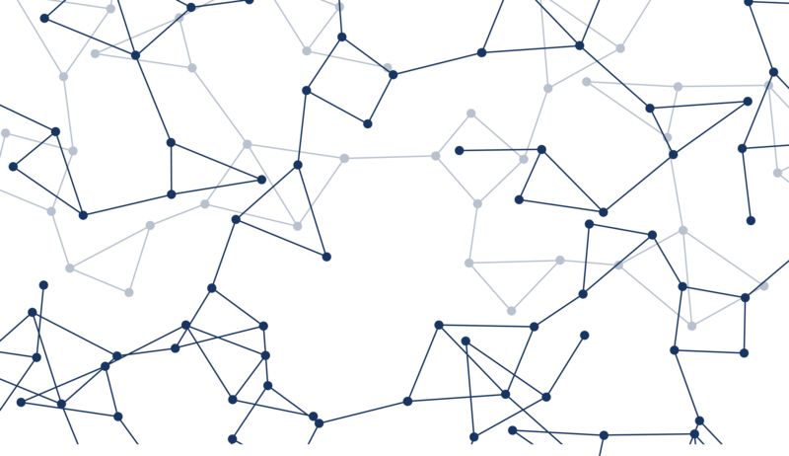
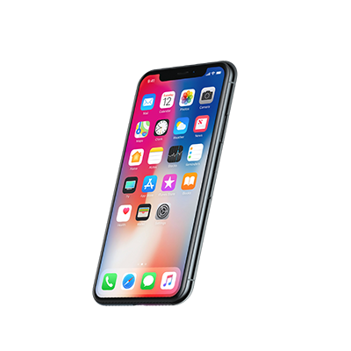






CONTENTS
INTRODUCTION
THE INTERNET OF THINGS TECHNOLOGY
HOW IS IoT POSSIBLE?
IoT APPLICATIONS
IoT NOW
ADVANTAGES
DISADVANTAGES
THE FUTURE OF IoT
THE ETHICAL VIEW
CONCLUSIONS

Slide 5



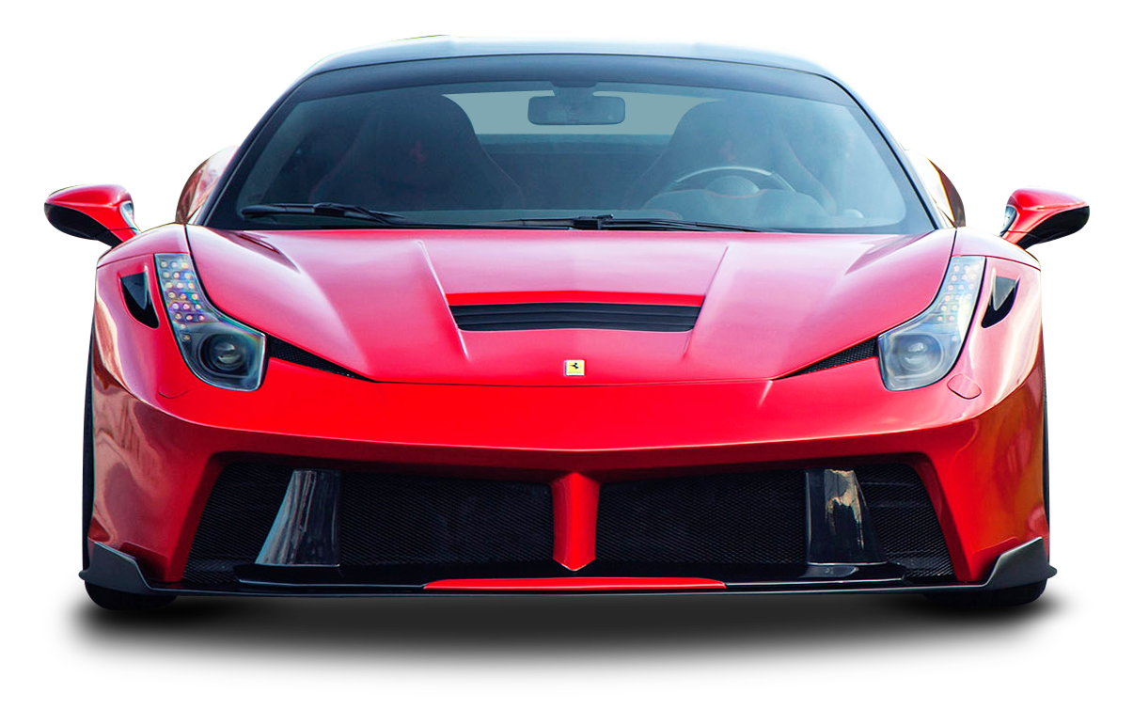
INTRODUCTION
Some important questions
Our motivations to research on this topic

Slide 6

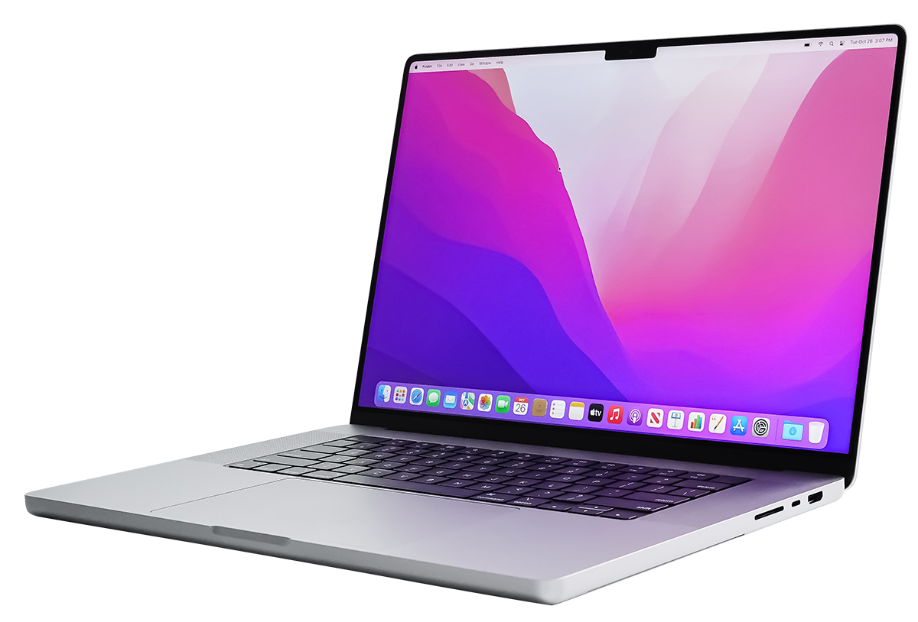


THE IMPORTANCE OF IoT
How present is IoT in our lives?

Slide 7
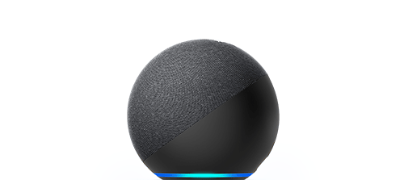



IoT BASES
Can you think of any examples in your lives of IoT?

Slide 8


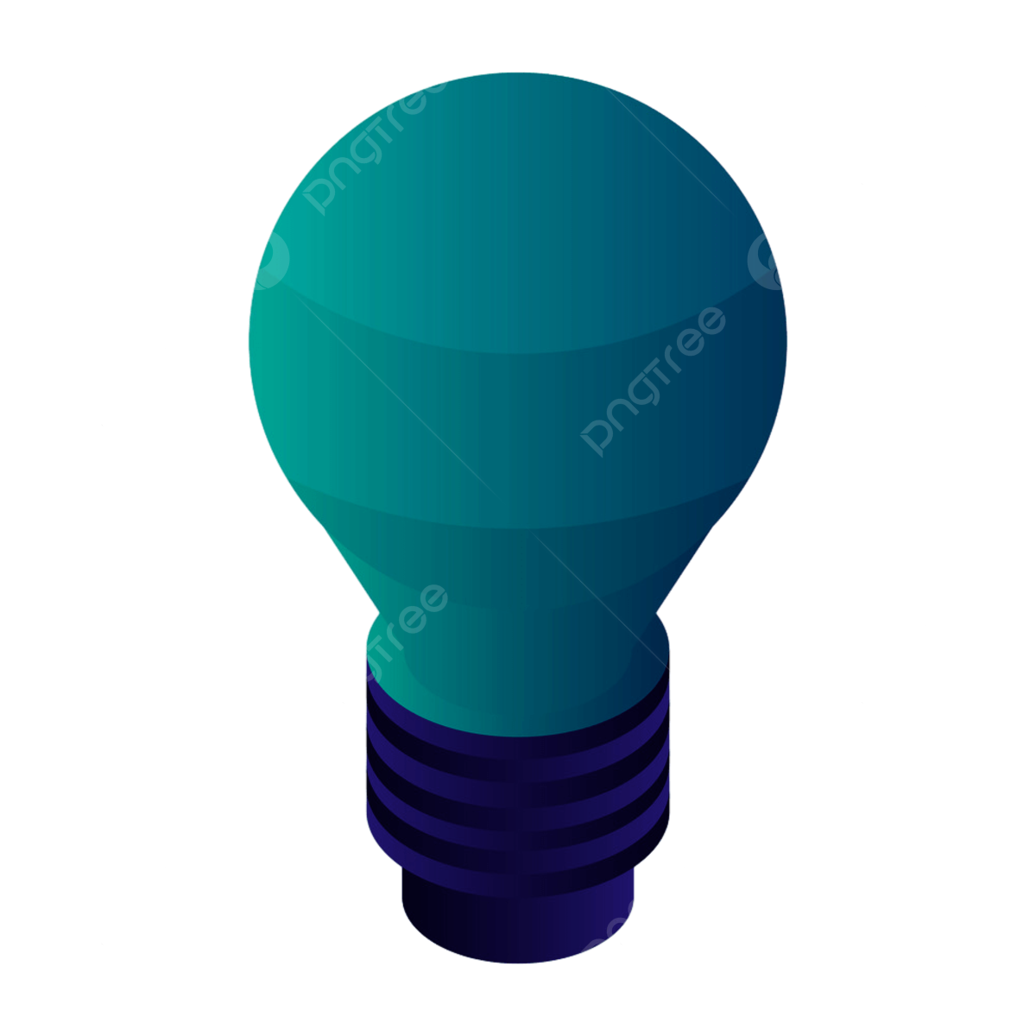

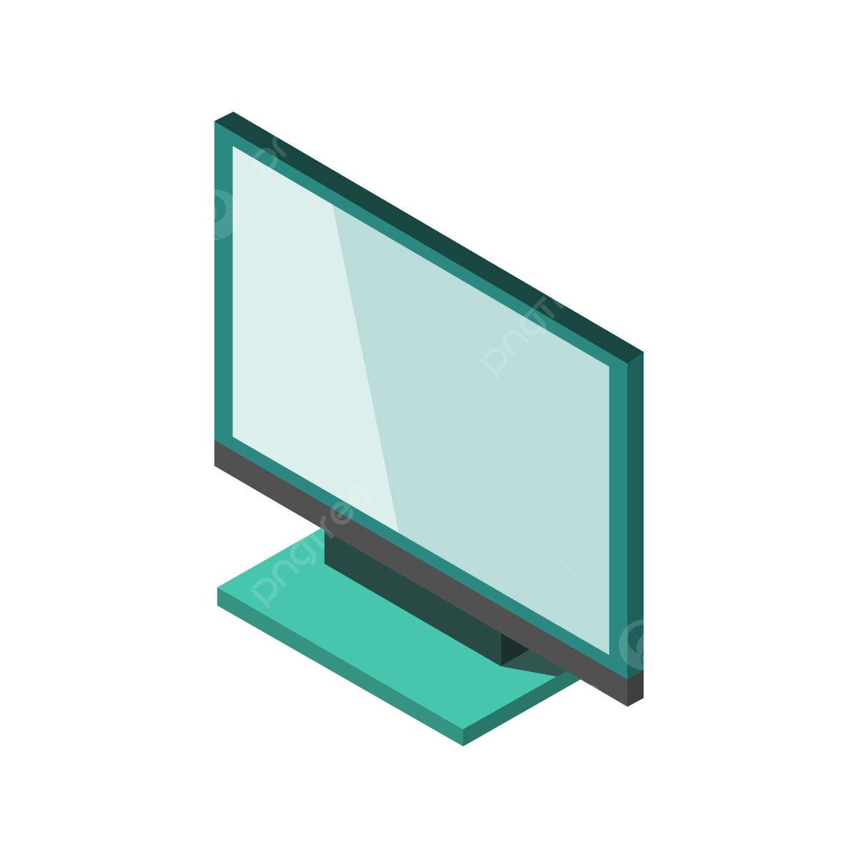
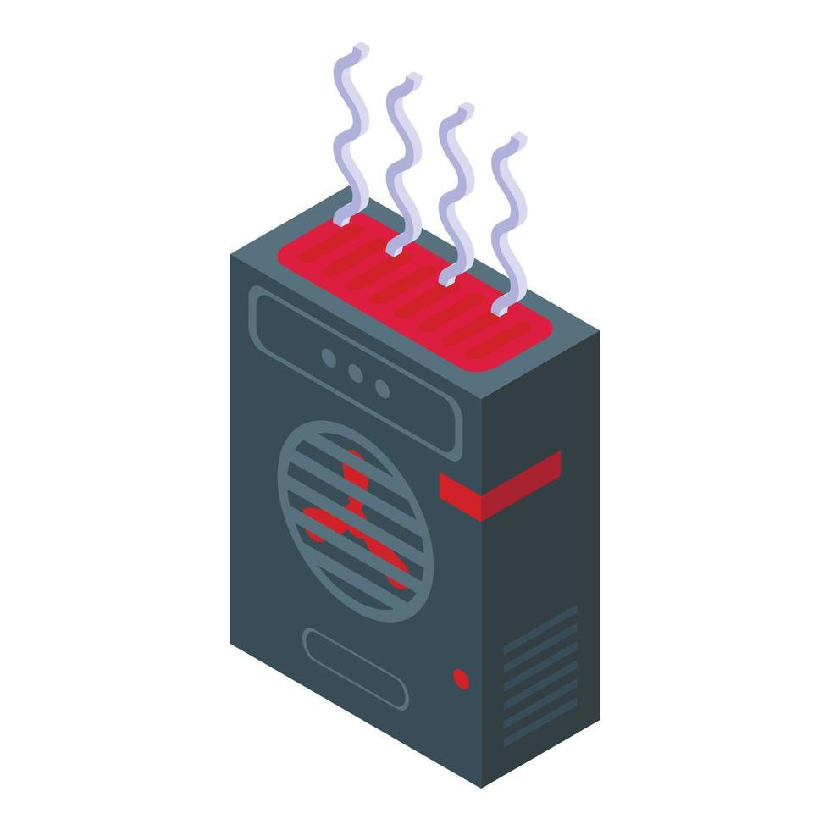
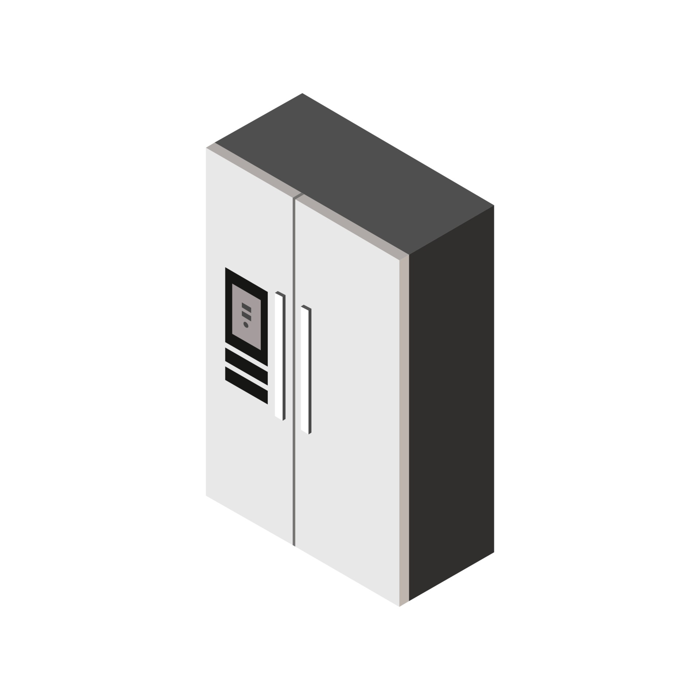
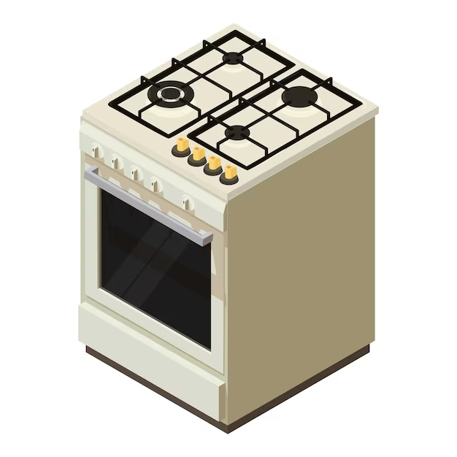
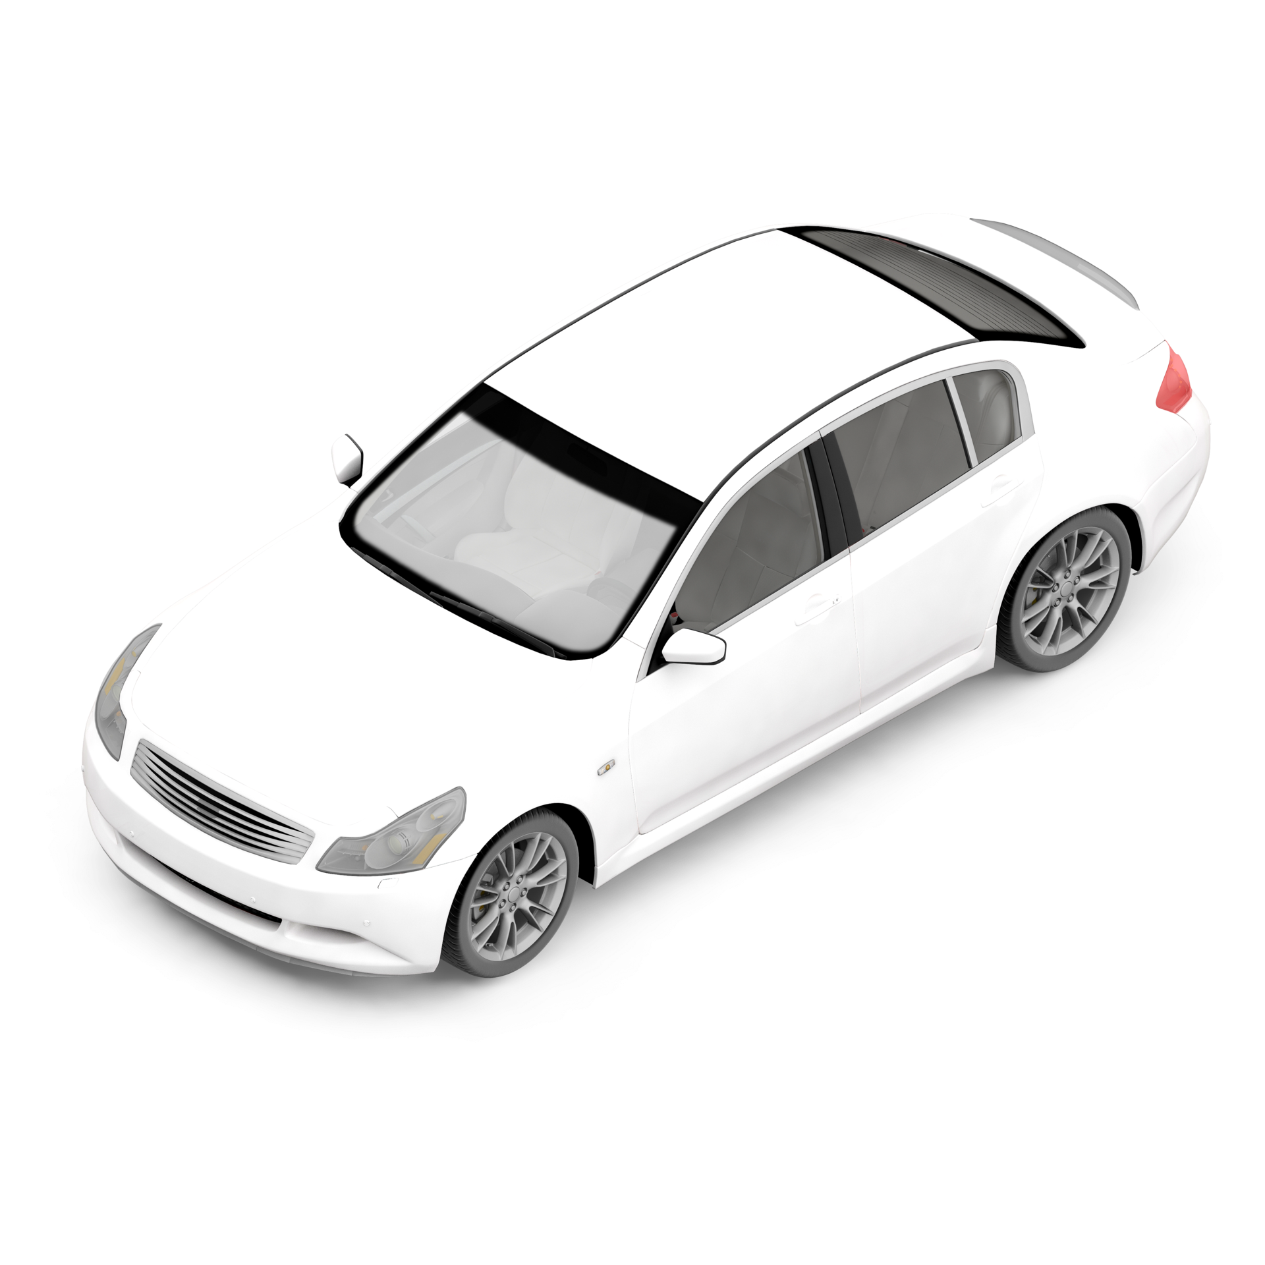
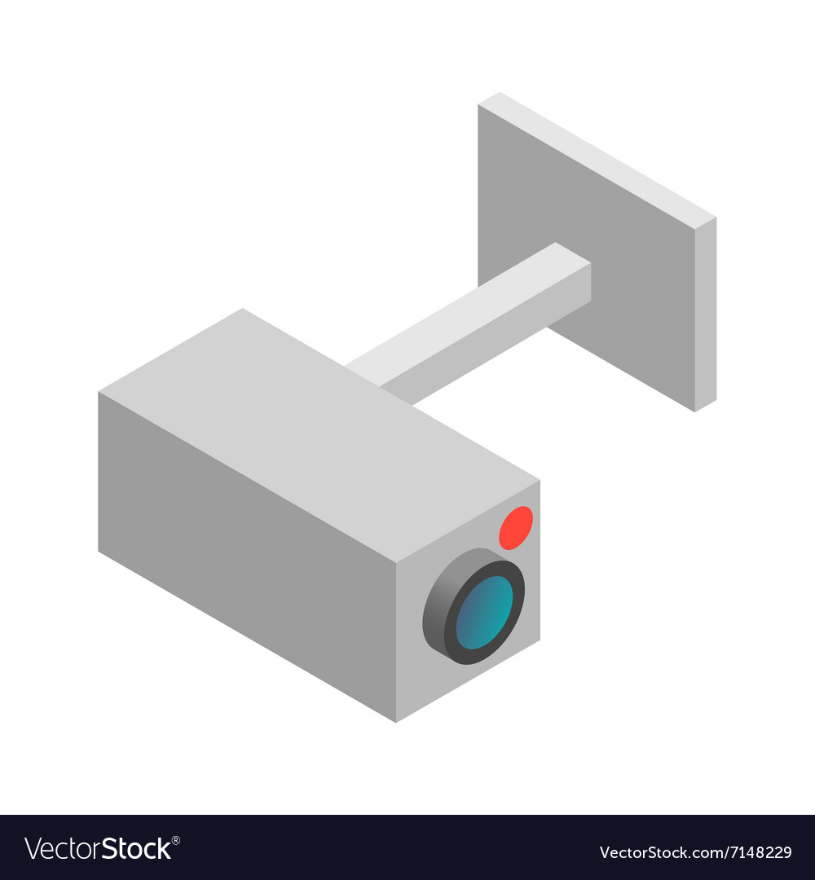
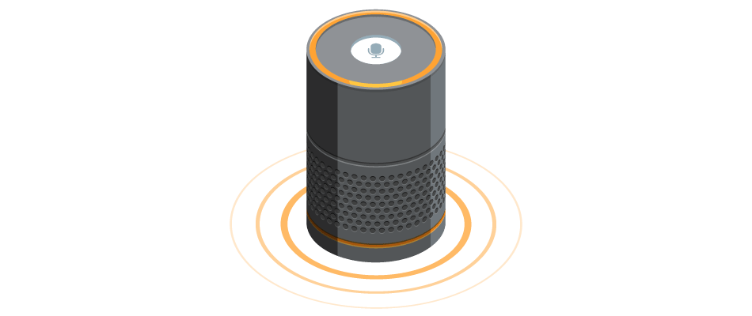

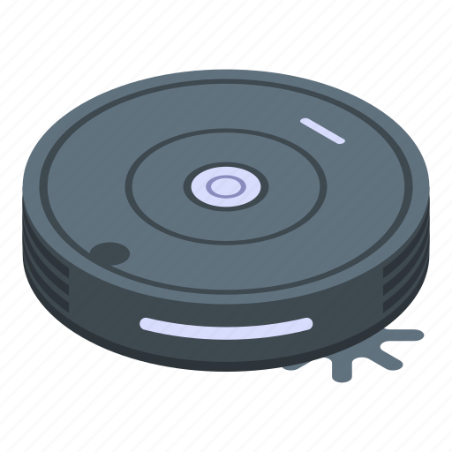
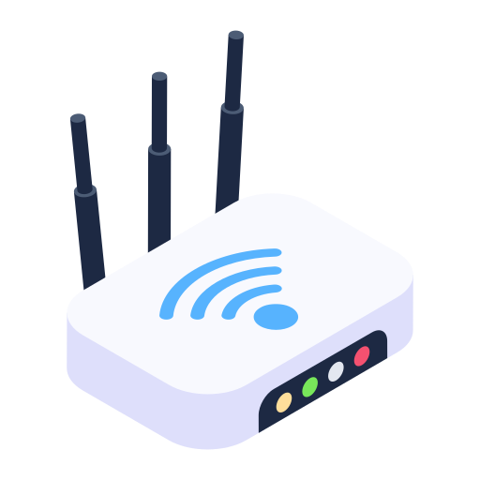
THE IoT TECHNOLOGY
INTRODUCTION

Slide 9
THE IoT TECHNOLOGY.
INTRODUCTION.

Slide 10
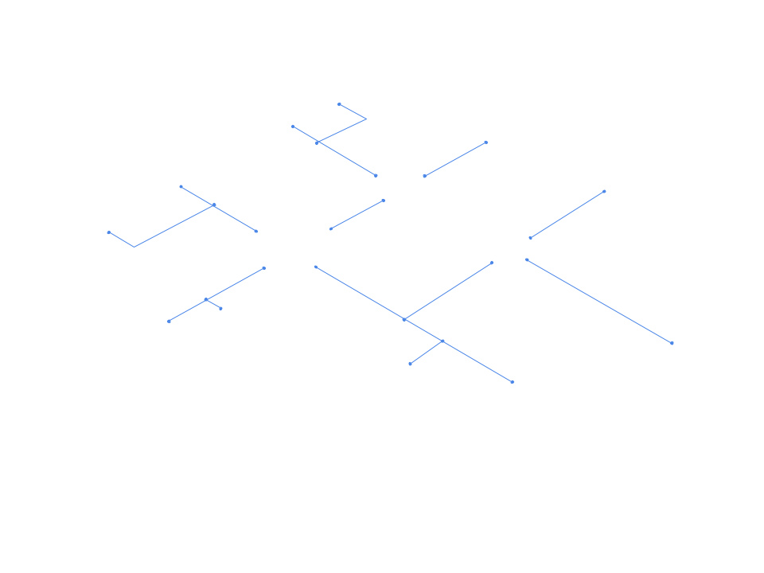
THE IoT TECHNOLOGY.
INTRODUCTION.
The Internet of Things (IoT) refers to the phenomenon that permits objects to process information and connect in between themselves through the internet or other network.

Slide 11
THE IoT TECHNOLOGY
HOW IS IoT POSSIBLE?
IoT was conceptualized a long time ago. However, it is possible thanks to a range of recent technological advancements which include:
Technological sensors have become cheaper
Improved connectivity
Cloud platforms development
Analytics development

Slide 12

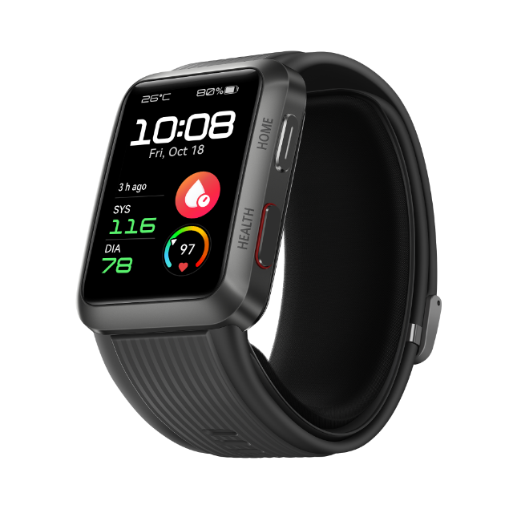

THE IoT TECHNOLOGY.
IoT APPLICATIONS

Slide 13
THE IoT TECHNOLOGY
IoT APPLICATIONS:
HEALTHCARE
Health can be monitored through the use of wearables like smart watches which can connect to other objects and transmit information through IoT technologies.

Slide 14
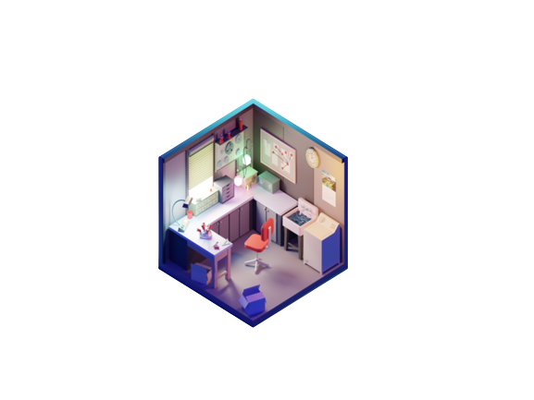
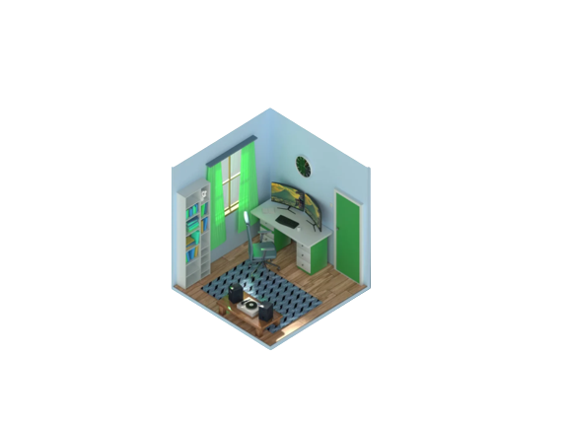
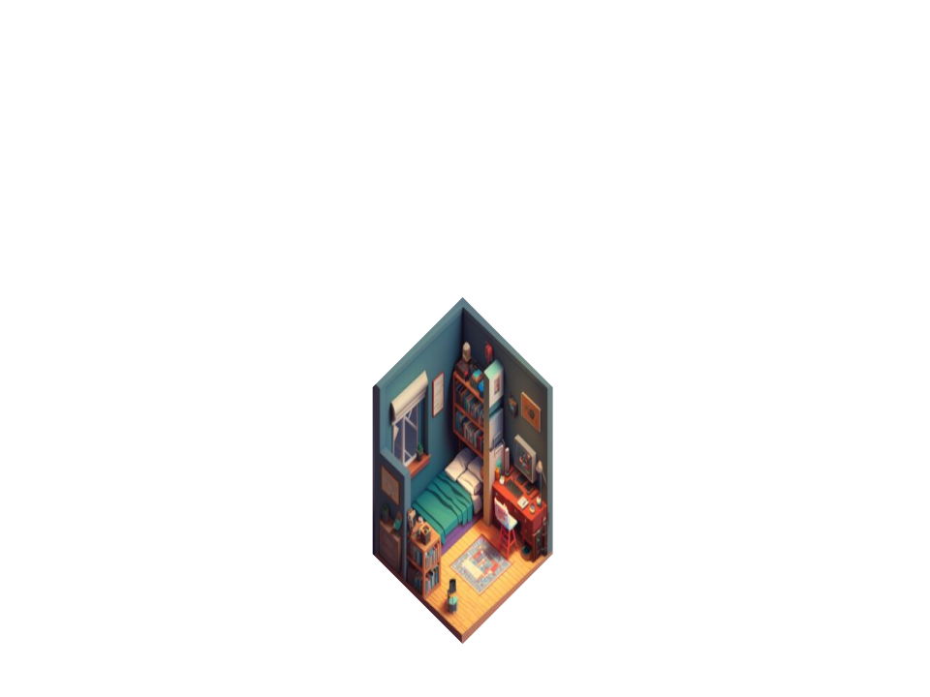
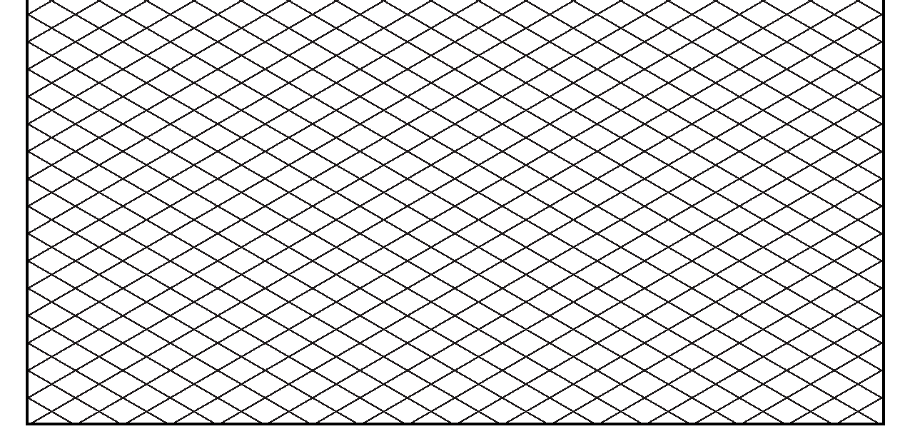
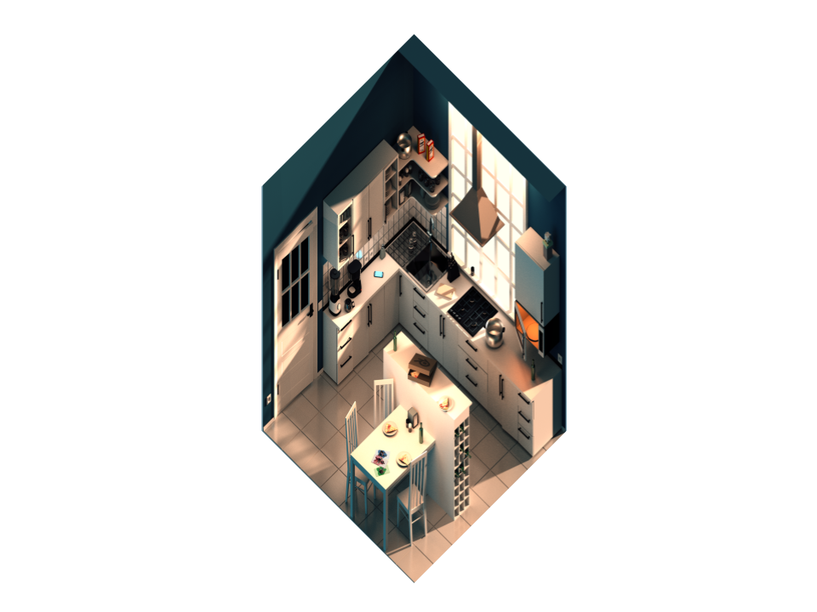
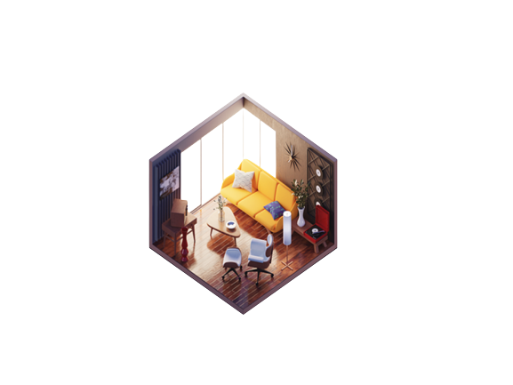


THE IoT TECHNOLOGY
IoT APPLICATIONS:
SMART GRIDS
Monitor and manage the transportation of electricity from the generation sources to meet the needs of the users.
Technologies:
Advanced metering infrastructure (AMI)
Smart Distribution Management Systems (SDMS)

Slide 15


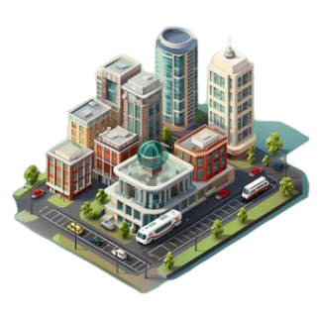
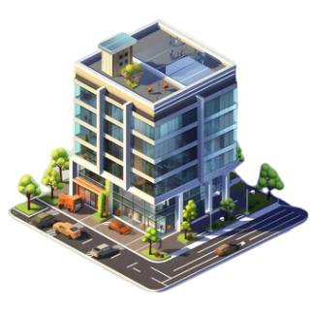
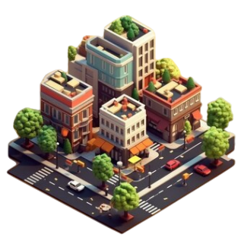
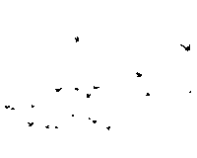
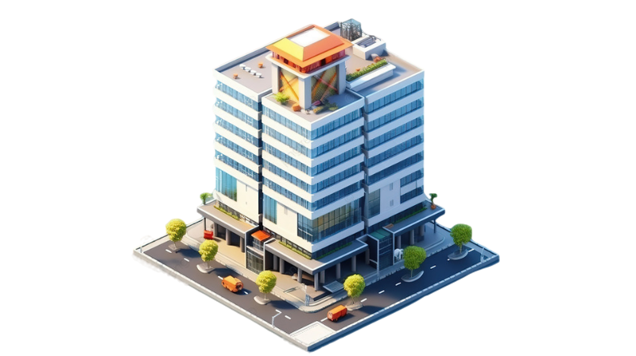
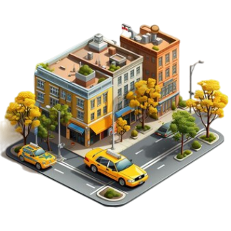
THE IoT TECHNOLOGY
IoT APPLICATIONS:
SMART GRIDS
Monitor and manage the transportation of electricity from the generation sources to meet the needs of the users.
Technologies:
Advanced metering infrastructure (AMI)
Smart Distribution Management Systems (SDMS)

Slide 16
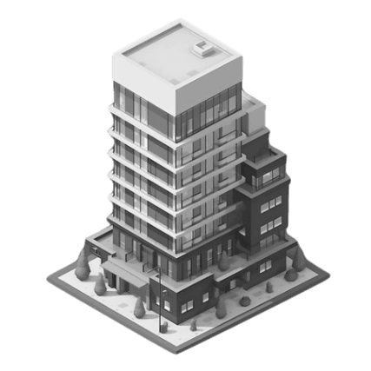
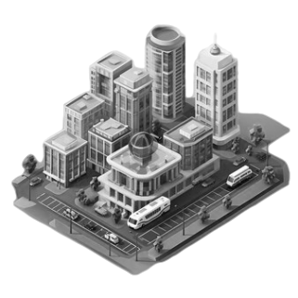
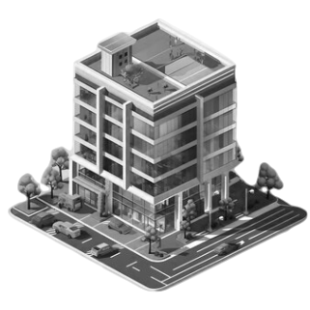
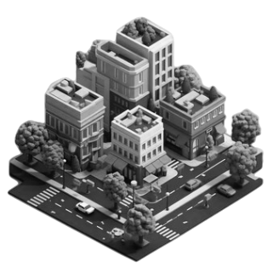
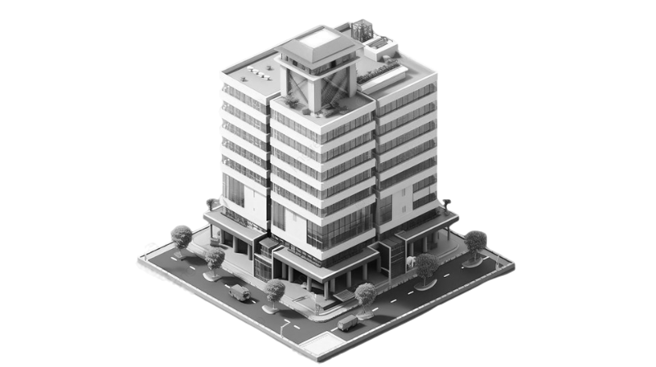
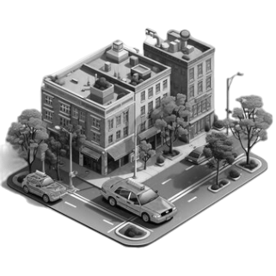
THE IoT TECHNOLOGY
IoT APPLICATIONS:
Minimise electricity consumption
SMART GRIDS
Smart distribution
Monitor and manage the transportation of electricity from the generation sources to meet the needs of the users.
Technologies:
Advanced metering infrastructure (AMI)
Smart Distribution Management Systems (SDMS)

Slide 17

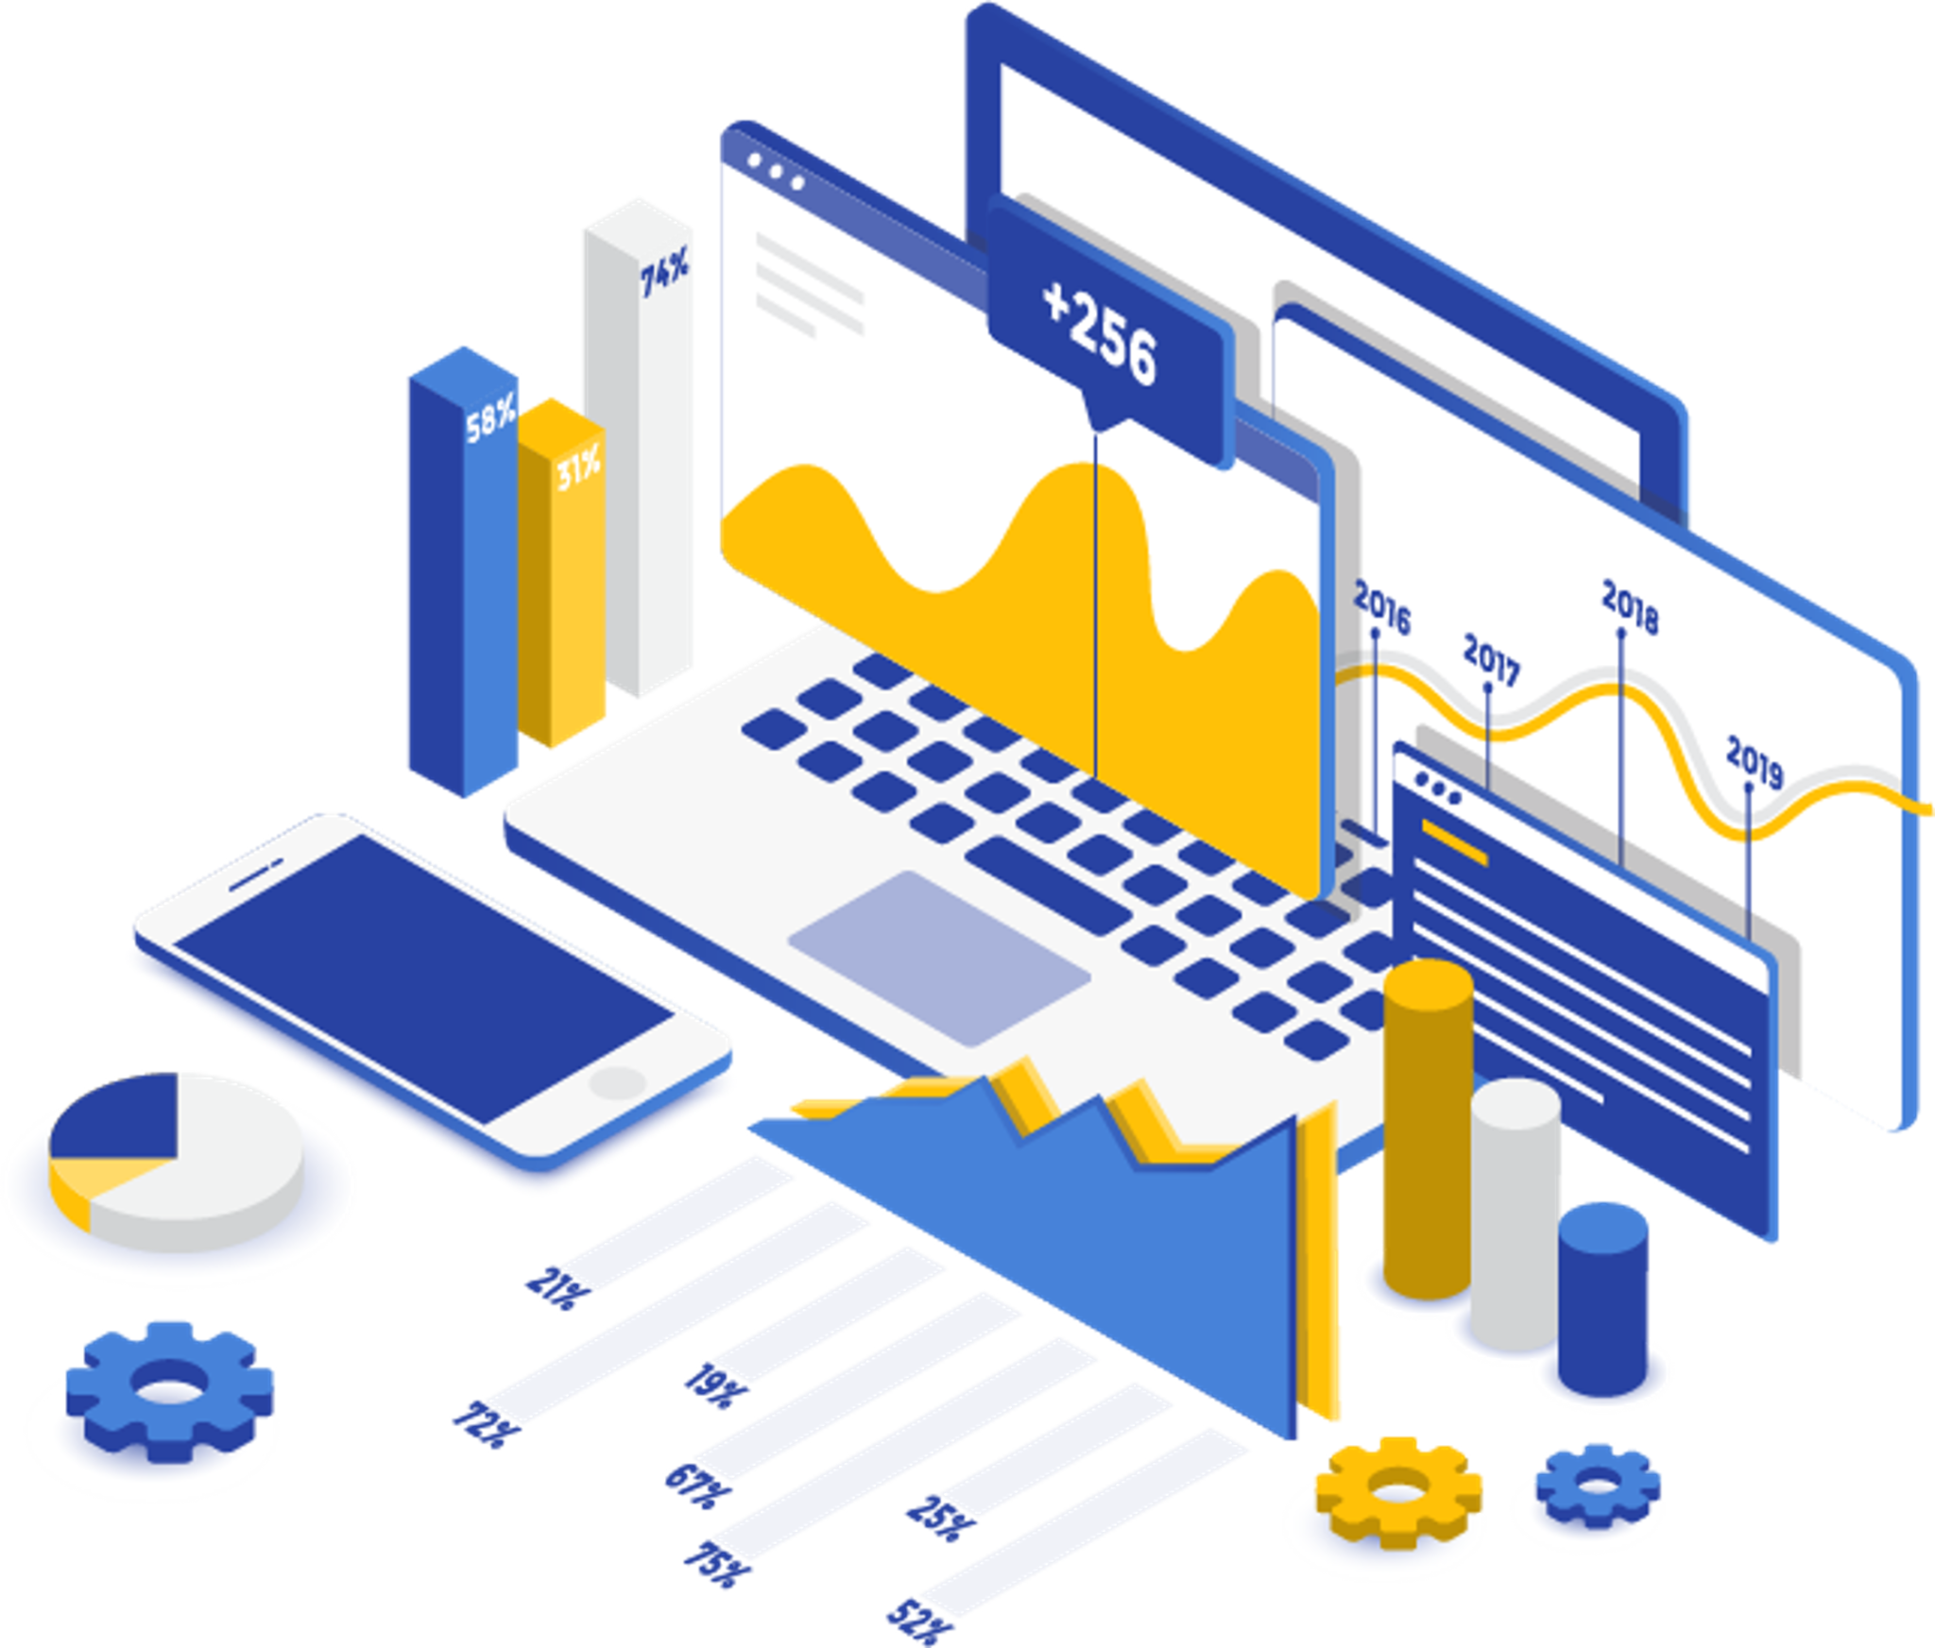

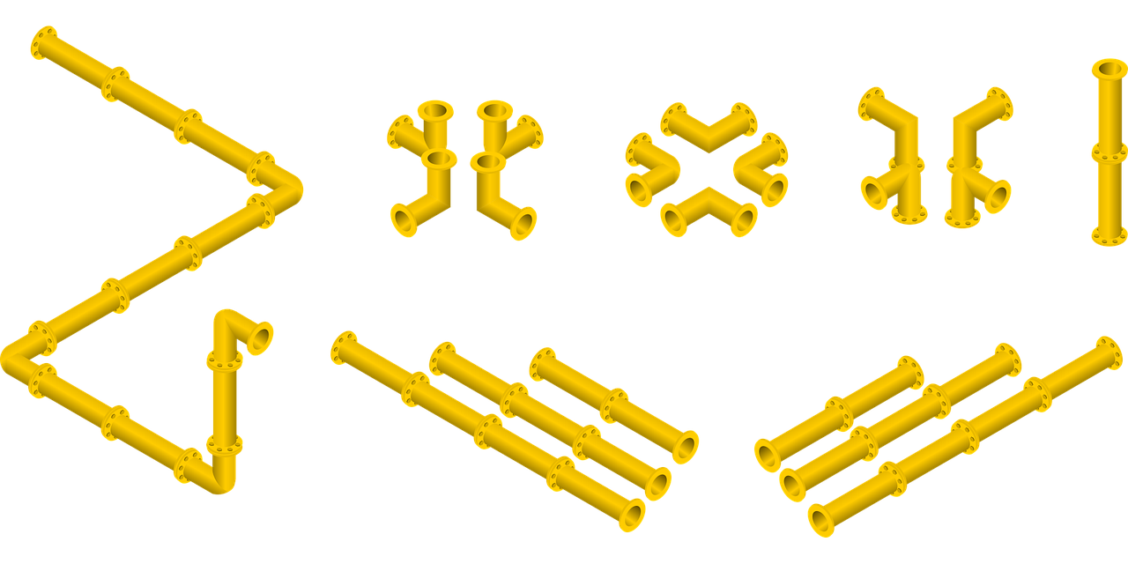

THE IoT TECHNOLOGY
IoT APPLICATIONS:
BLOCK CHAINS
Distributed digital systems consisting of a chain of blocks that contain transactional data shared across a network of individuals that are connected to this network in an encrypted form.

Slide 18
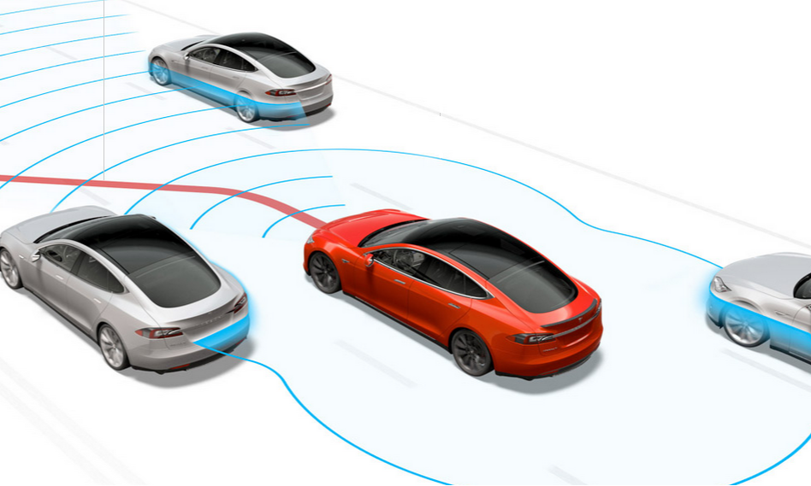
THE IoT TECHNOLOGY
IoT APPLICATIONS:
SELF DRIVING CARS

Slide 19
IoT NOW
ADVANTAGES

Slide 20



IoT NOW
ADVANTAGES
SMART GRIDS

Slide 21
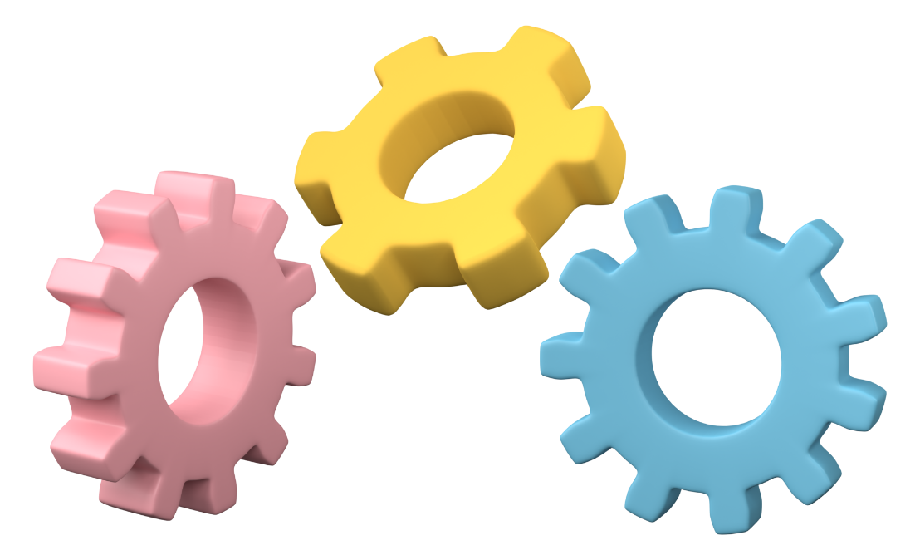


IoT NOW
ADVANTAGES
AUTOMATION OF TASKS AND PROCESSES

Slide 22
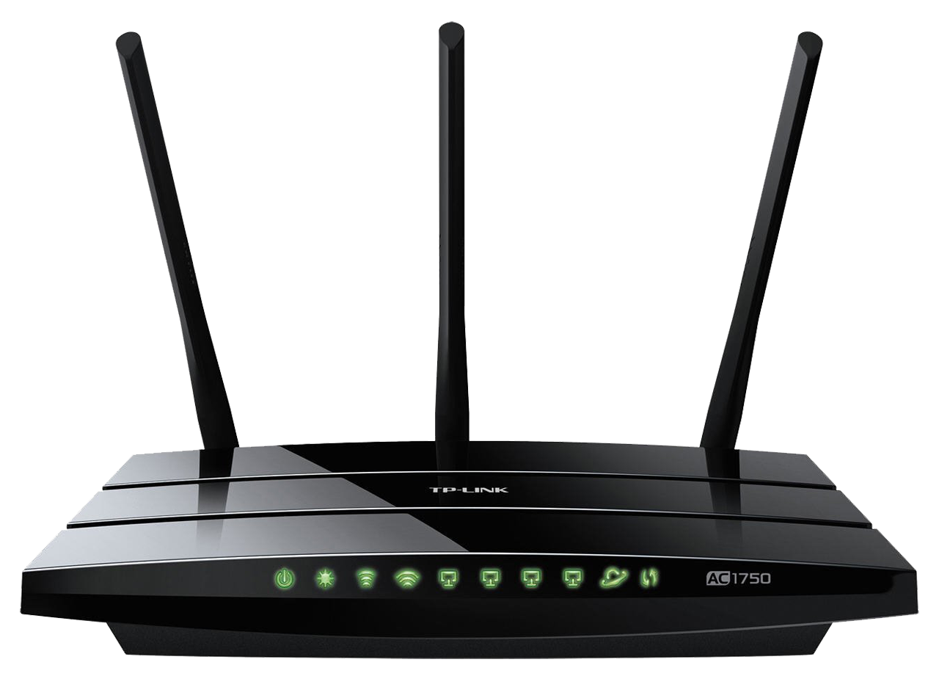

IoT NOW
ADVANTAGES
INTERNET CONNECTIVITY

Slide 23
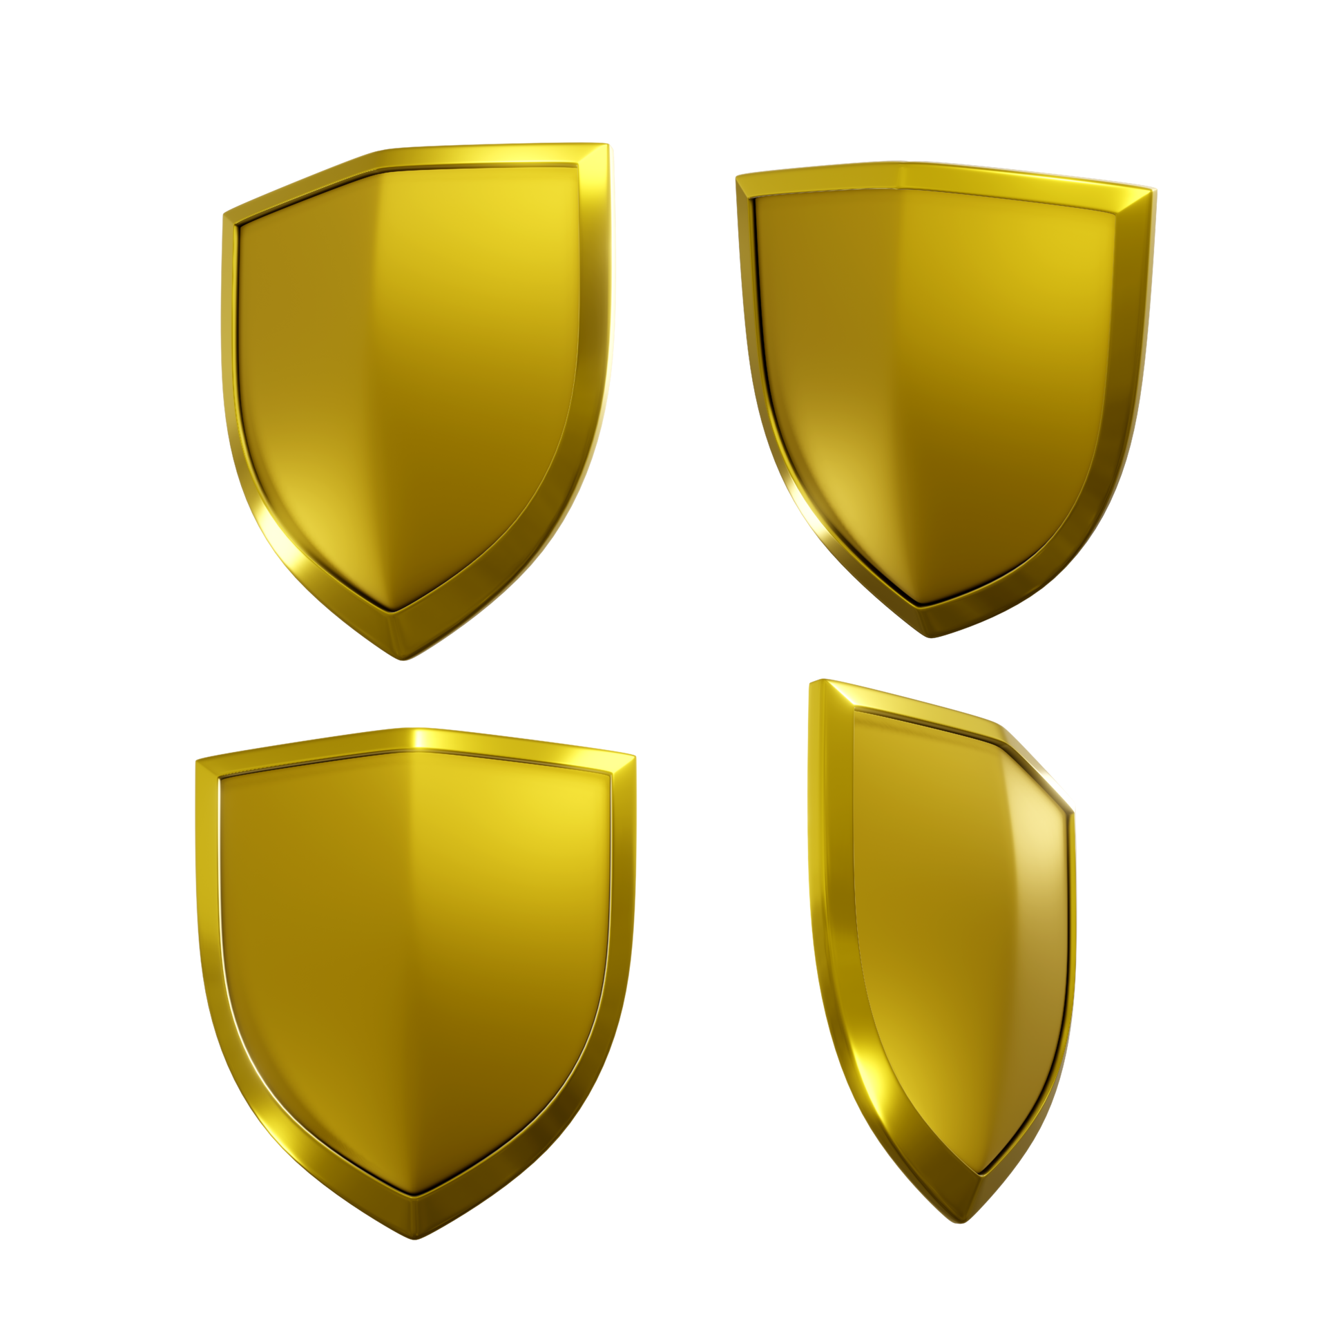

IoT NOW
ADVANTAGES
SECURITY

Slide 24

IoT NOW
ADVANTAGES
HEALTH

Slide 25
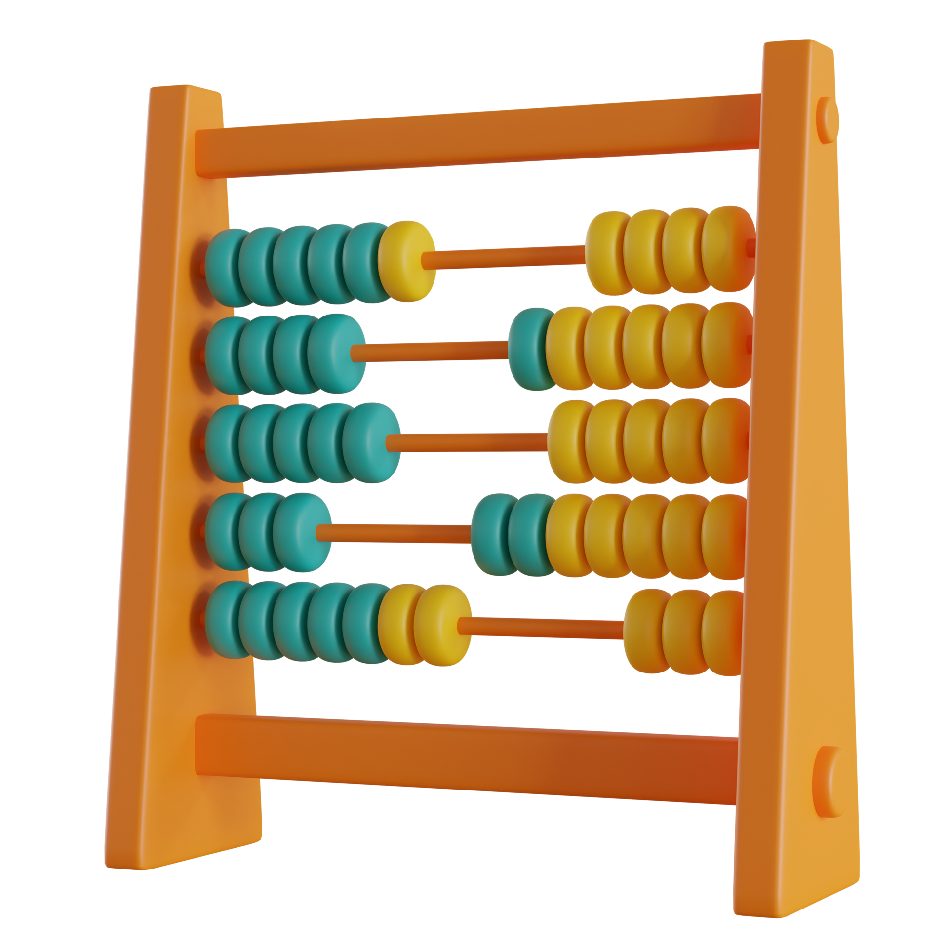
IoT NOW
ADVANTAGES
DATA COLLECTION AND ANALYSIS

Slide 26

IoT NOW
ADVANTAGES
DEVELOPEMENT OF NEW TECHNOLOGIES

Slide 27
IoT NOW
DISADVANTAGES

Slide 28



IoT NOW
DISADVANTAGES
COST

Slide 29



IoT NOW
DISADVANTAGES
SECURITY VULNERABILITIES

Slide 30
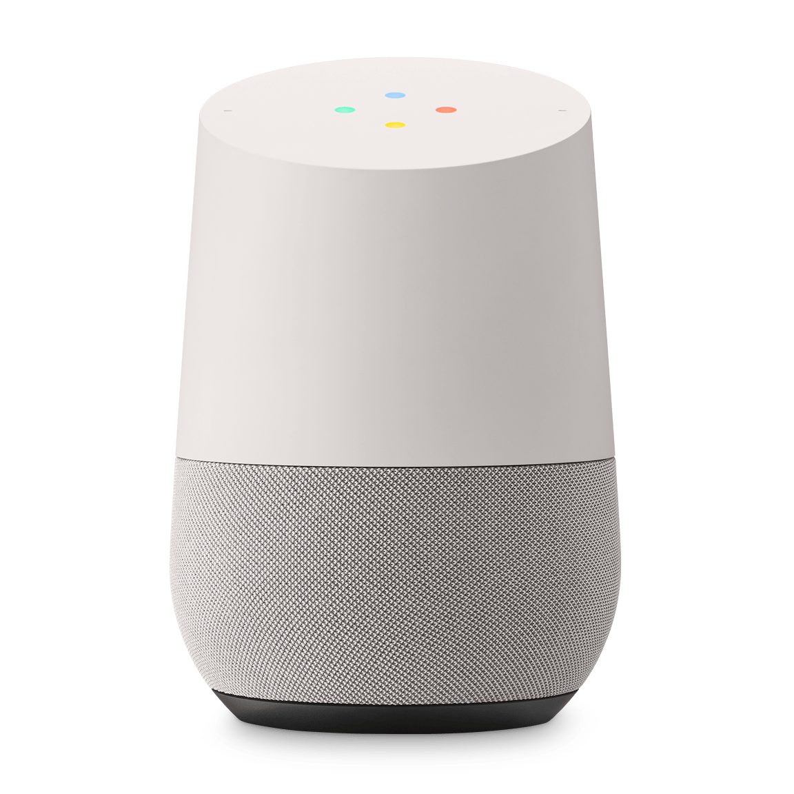

IoT NOW
DISADVANTAGES
PRIVACY

Slide 31
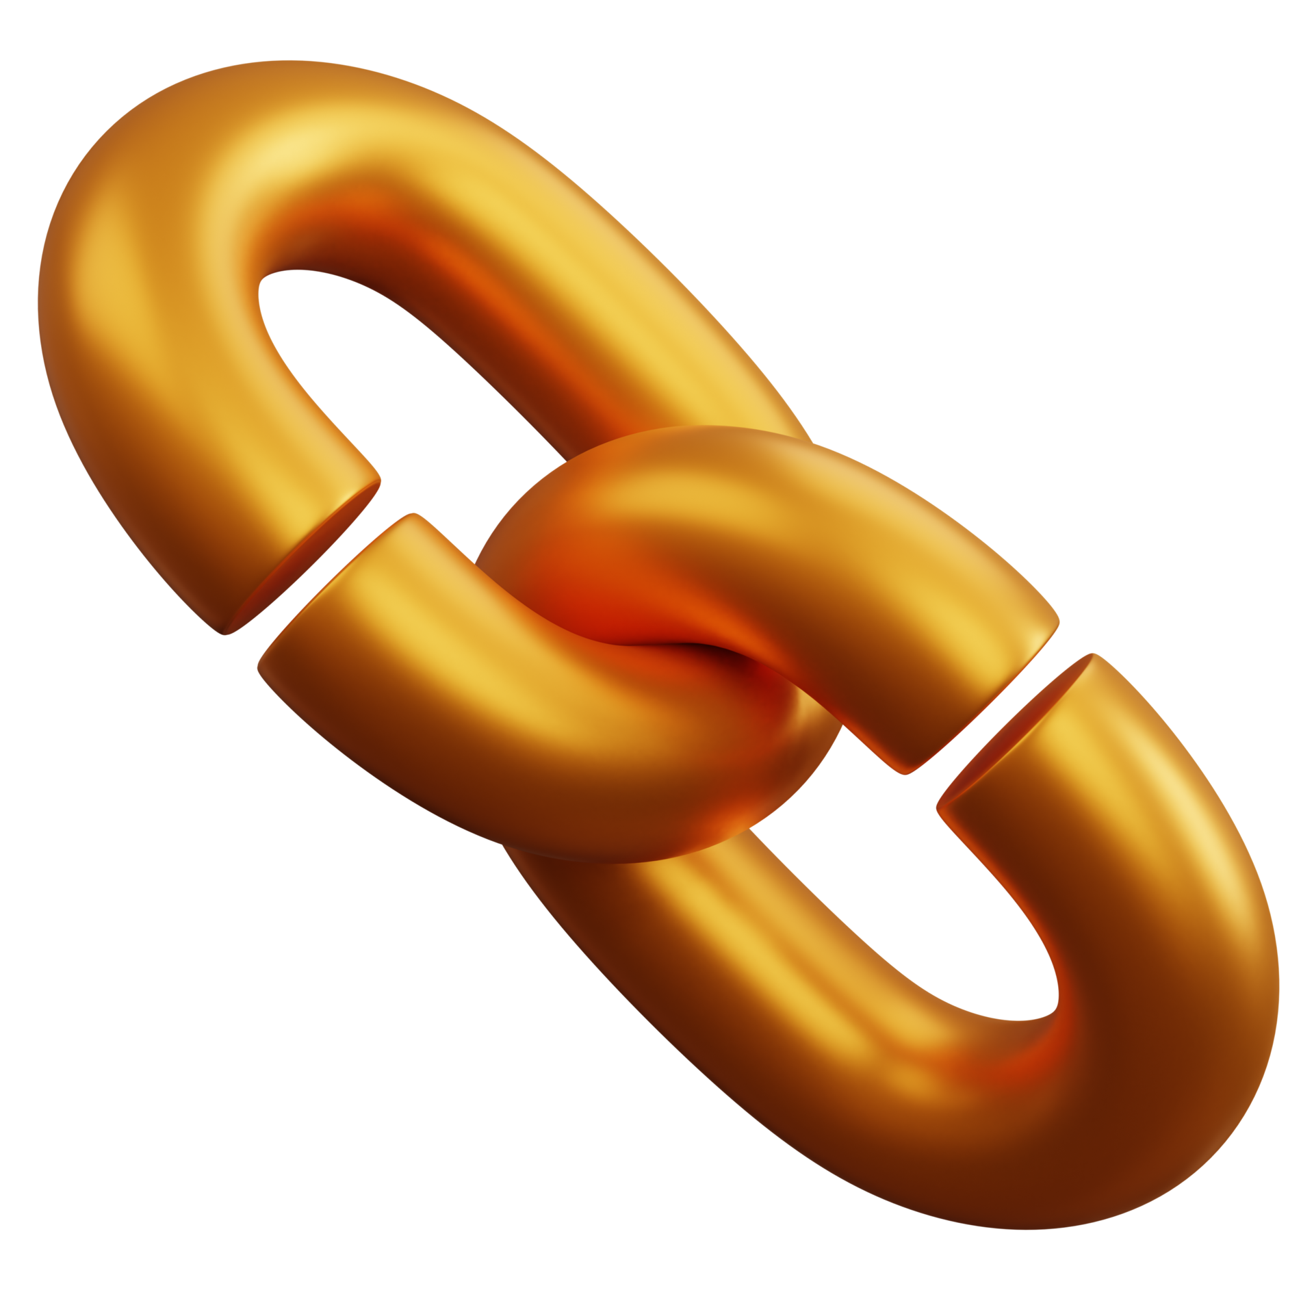

IoT NOW
DISADVANTAGES
DEPNDENCY

Slide 32


IoT NOW
ç
DISADVANTAGES
COMPLEXITY

Slide 33
THE FUTURE OF IoT

Slide 34


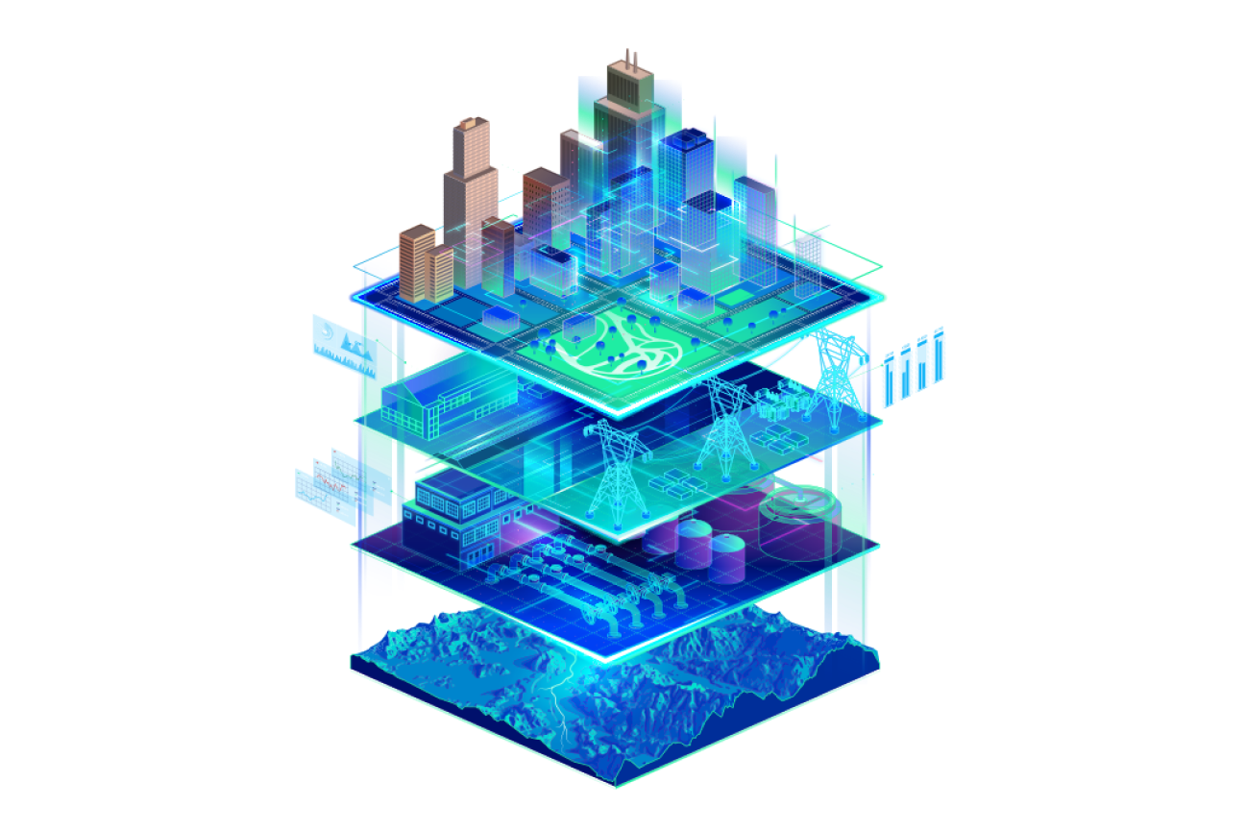
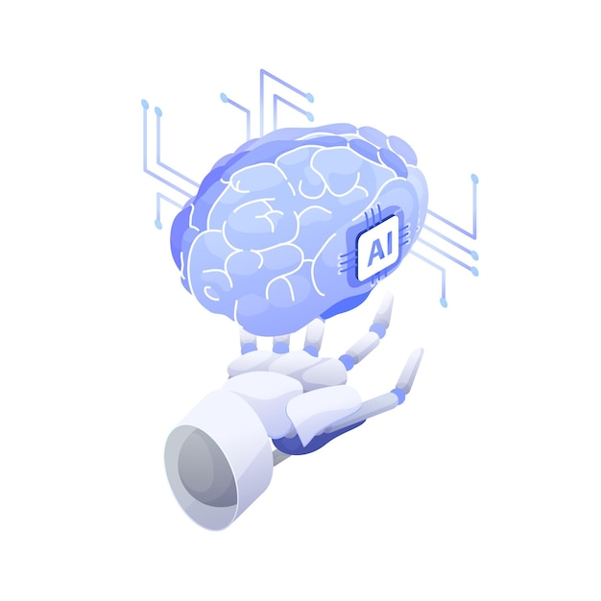
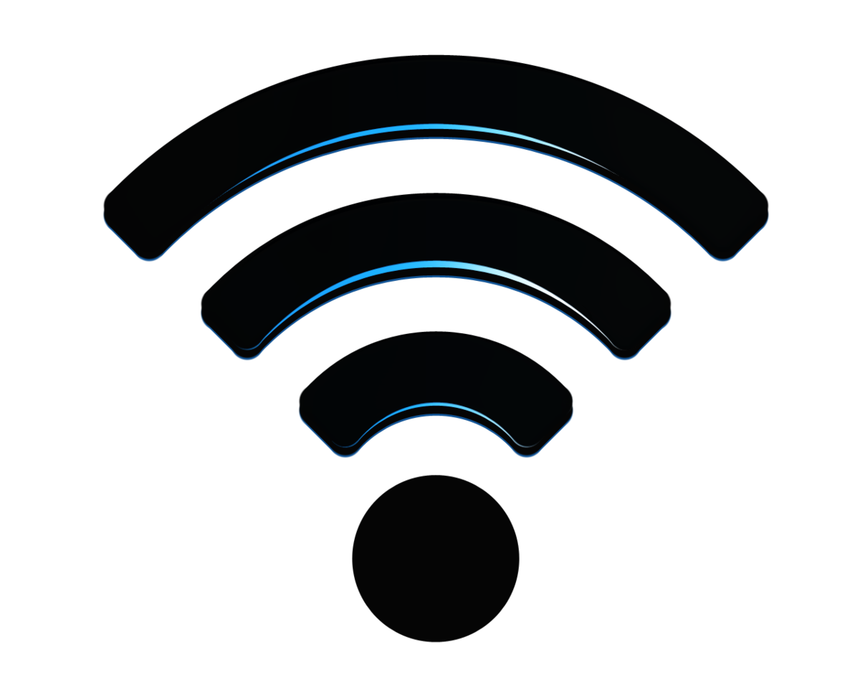

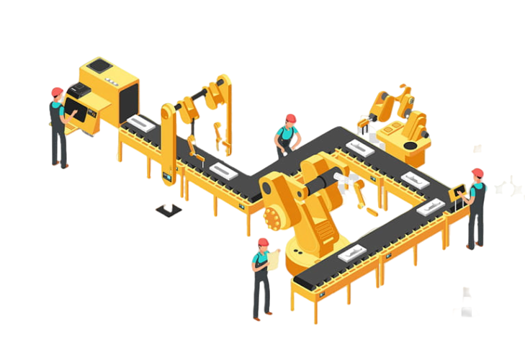

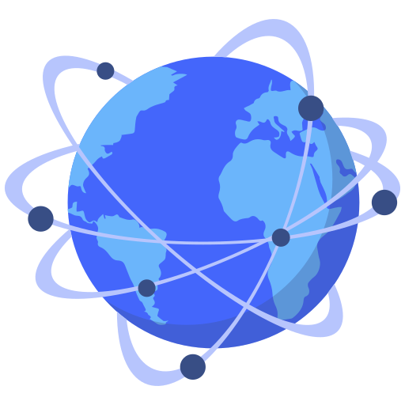


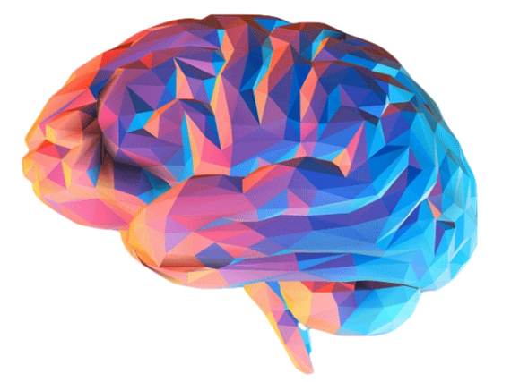
THE FUTURE OF IoT
What can we expect?
DIGITAL TWINS/ OBJECTS CLONING
ARTIFICIAL INTELLIGENCE
IMPACT ON THE ECONOMY
PUBLIC INFRASTRUCTTURES
MANIFACTURING
COMMUNICATION REVOLUTION
INTERNET
MEDICAL MONITORING AND DATA RECOLLECTION
HOME MANAGEMENT

Slide 35
THE ETHICAL VIEW

Slide 36

THE IoT TECHNOLOGY
ETHICAL ISSUES
Despite great advantages from the IoT technology, some important problems can be spotted related to the use people can make of these technologies:
Privacy
Security
Environmental concerns

Slide 37

OUR CONCLUSIONS

Slide 38



OUR CONCLUSIONS

